Slide 1


Deep Learning
Sign Language detector
Presented by : AARAB Yousra
ABERKCHANE Kawtar
1

Slide 2
Plan
Plan
Project Overview
Followed Process
1
4
Used DataSet
Tools & libraries
2
5
Architecture
6
Results
3
2

Slide 3




Project Overview
About One billion people in the world lives with disabilities
5
About
Of those about 275 million have hearing loss
million have profound deafness.
3

Slide 4


Dataset
Sign langauge dataset
The American Sign Language Letters dataset
is an object detection dataset of each ASL
letter with a bounding box by David Lee a
Data scientist
4

Slide 5
Dataset settings
Source Images
Train/Test split
Images : 720
Training Set : 504 images
classes : 26
Validation Set : 144 images
Letters from A to Z
Testing Set : 72 images
5

Slide 6
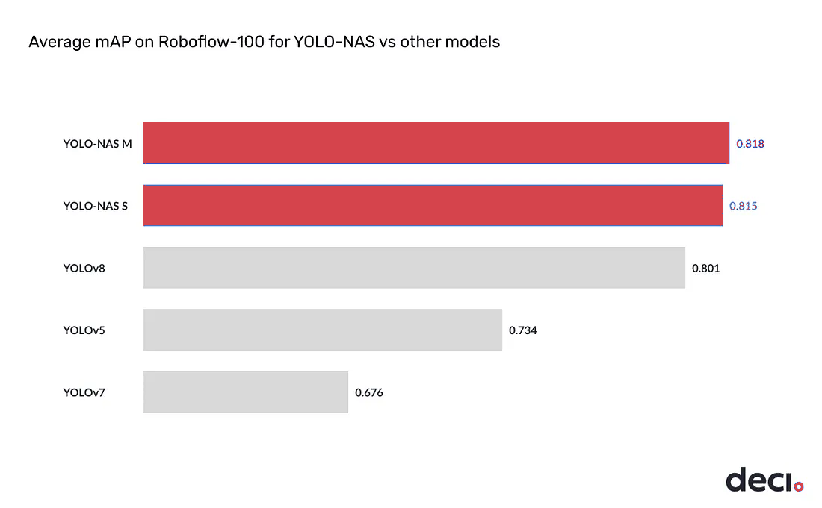
Architecture
YOLO-NAS
mAP on Roboflow 100
YOLO

Slide 7
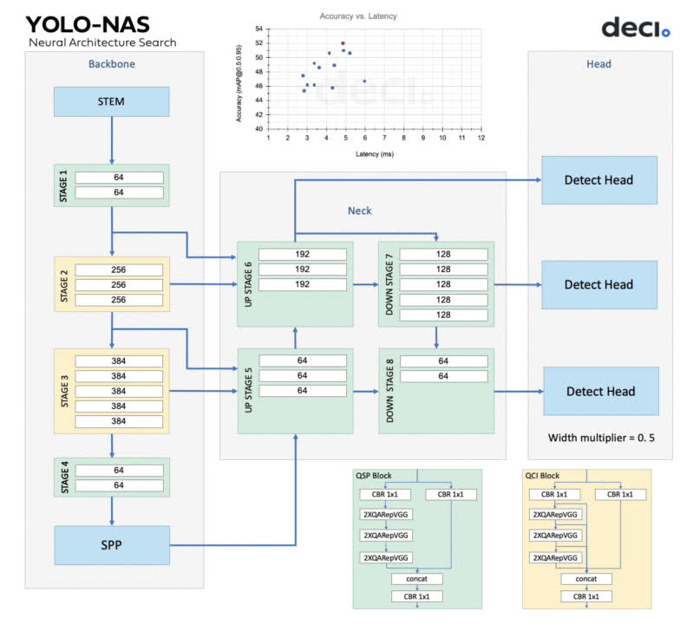

Architecture
Key Features
AutoNAC
optimal sizes of stages
QCP & QCI
Minimize accuracy loss
Roboflow
trained on a collection
6

Slide 8
Process
2
1
2
1
3
3
4
4
5
5
2
6
Environment Setup
Required packages.
Essential libraries.

Slide 9
Process
Dataset Preparation
2
1
2
1
3
3
4
4
5
5
2
6
Export and Import the dataset.
Configure dataset parameters.

Slide 10
Process
2
1
2
1
3
3
4
4
5
5
2
6
Training Setup and Model
Set checkpoint .
Instantiate the trainer.
Define metrics, training parameters, and model instantiation for FineTuning.

Slide 11
Process
Data Handling and Inspection
2
1
2
1
3
3
4
4
5
5
2
6
Load, visualize, and inspect the dataset

Slide 12
Process
2
1
2
1
3
3
4
4
5
5
2
6
Training and Evaluation
Execute model training.
Get the best trained model
Evaluate the best model's performance.

Slide 13
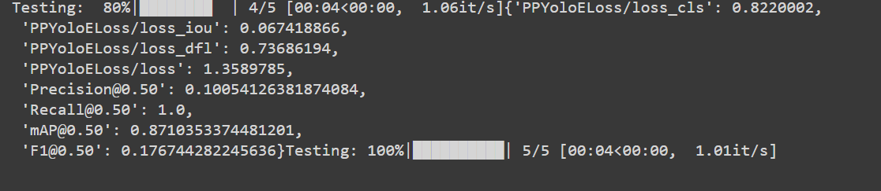
Process
Precision@0.50 = 0.1
Recall@0.50 = 1.0 => it captures all actual positives.
mAP@0.50 = 0.87 => better performance.
F1@0.50 = 0.17

Slide 14
Process
Inference
2
1
2
1
3
3
4
4
5
5
2
6
Use the trained model for inference.

Slide 15



Tools
9

Slide 16
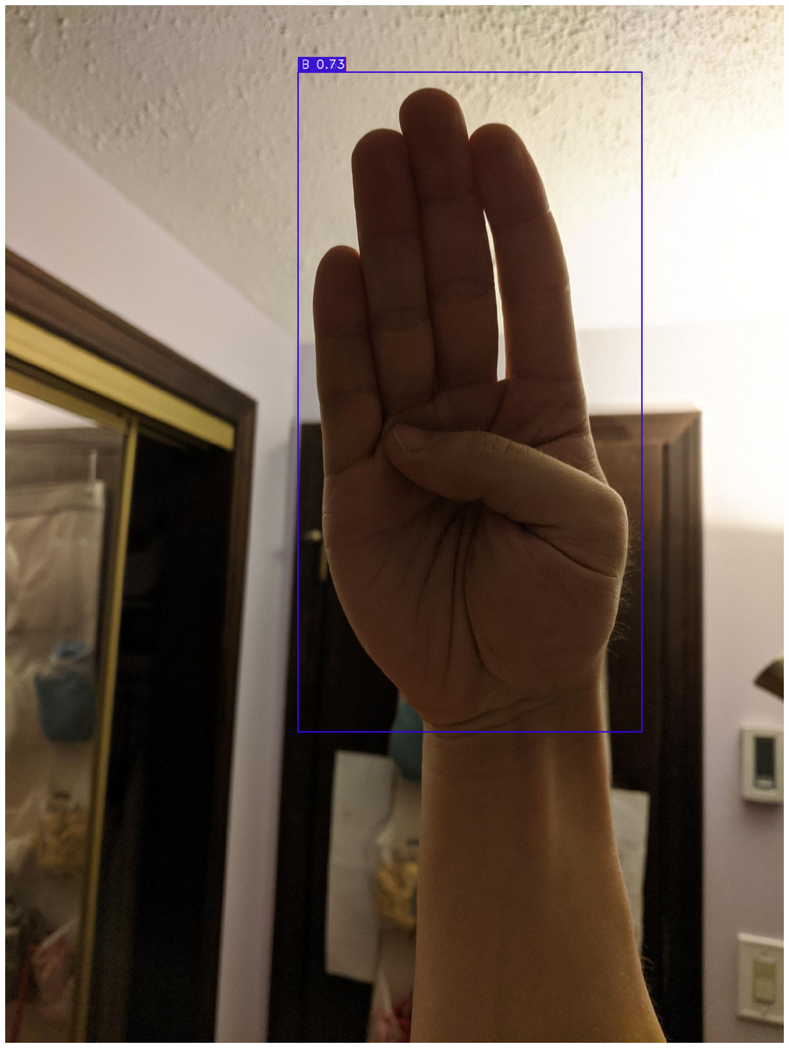
Demo
Test on image
12

Slide 17
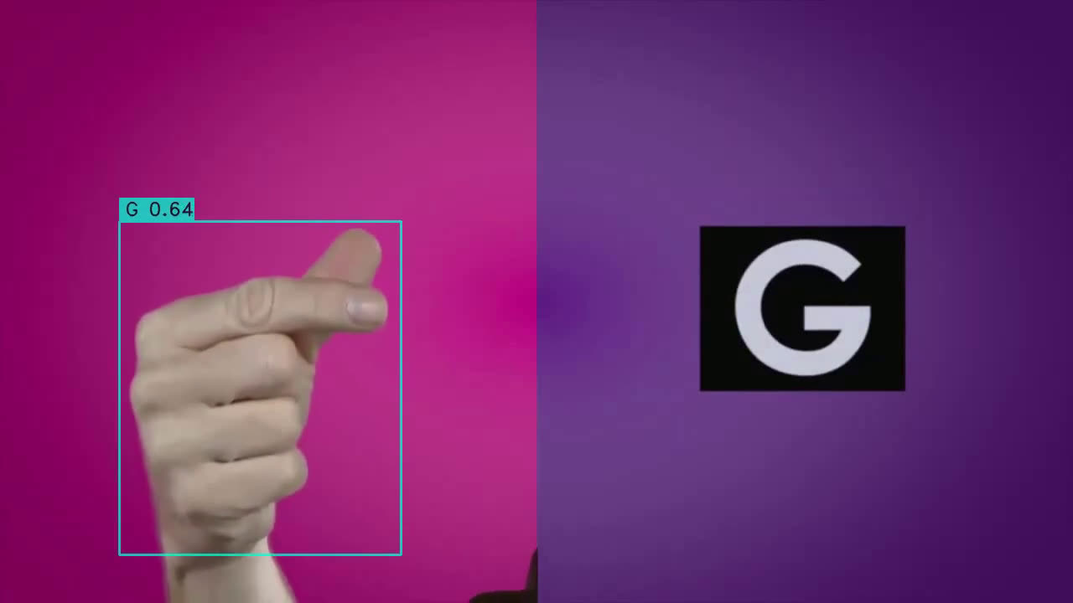
Demo
Test on a video
13

Slide 18
Application
13

Slide 19
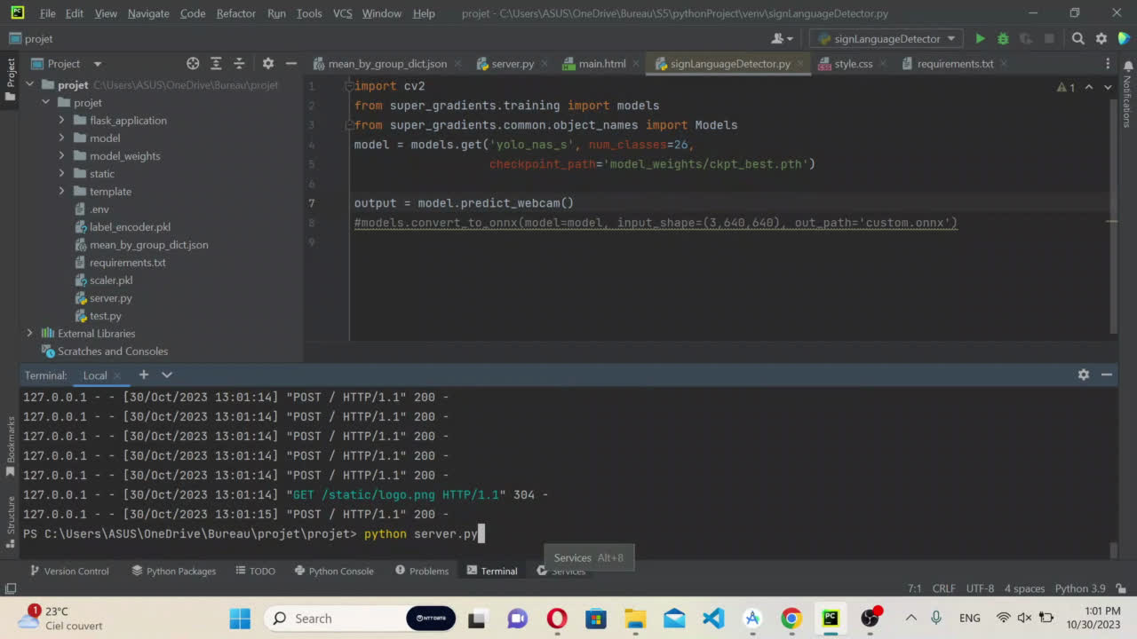
13

Slide 20
13

Slide 21
Thank you for your attention !!
18

